Slide 1
Comparing Automated Factual Claim Detection Against Judgments of Journalism Organizations
Naeemul Hassan#, Mark Tremayne, Fatma Arslan, Chengkai Li
University of Texas at Arlington
2016 Computation + Journalism Symposium, Sept. 30th, 2016
# The author is now with University of Mississippi

Slide 2

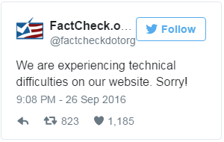

Fact-checking at Peak

Slide 3
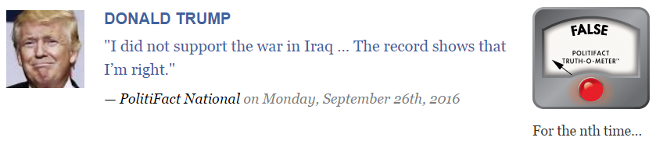
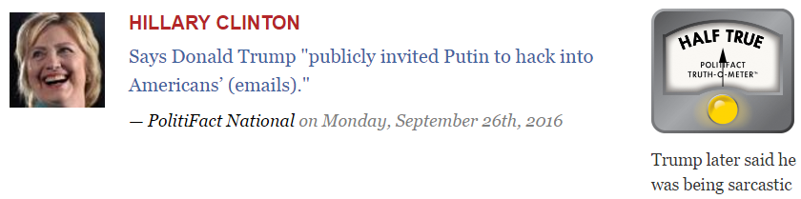
Fact-checking the Presidential Debates
http://www.politifact.com/
http://www.politifact.com/

Slide 4
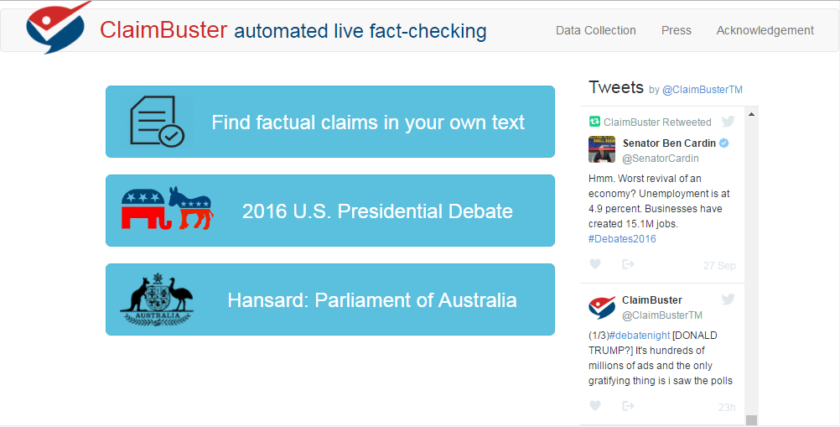

Slide 5
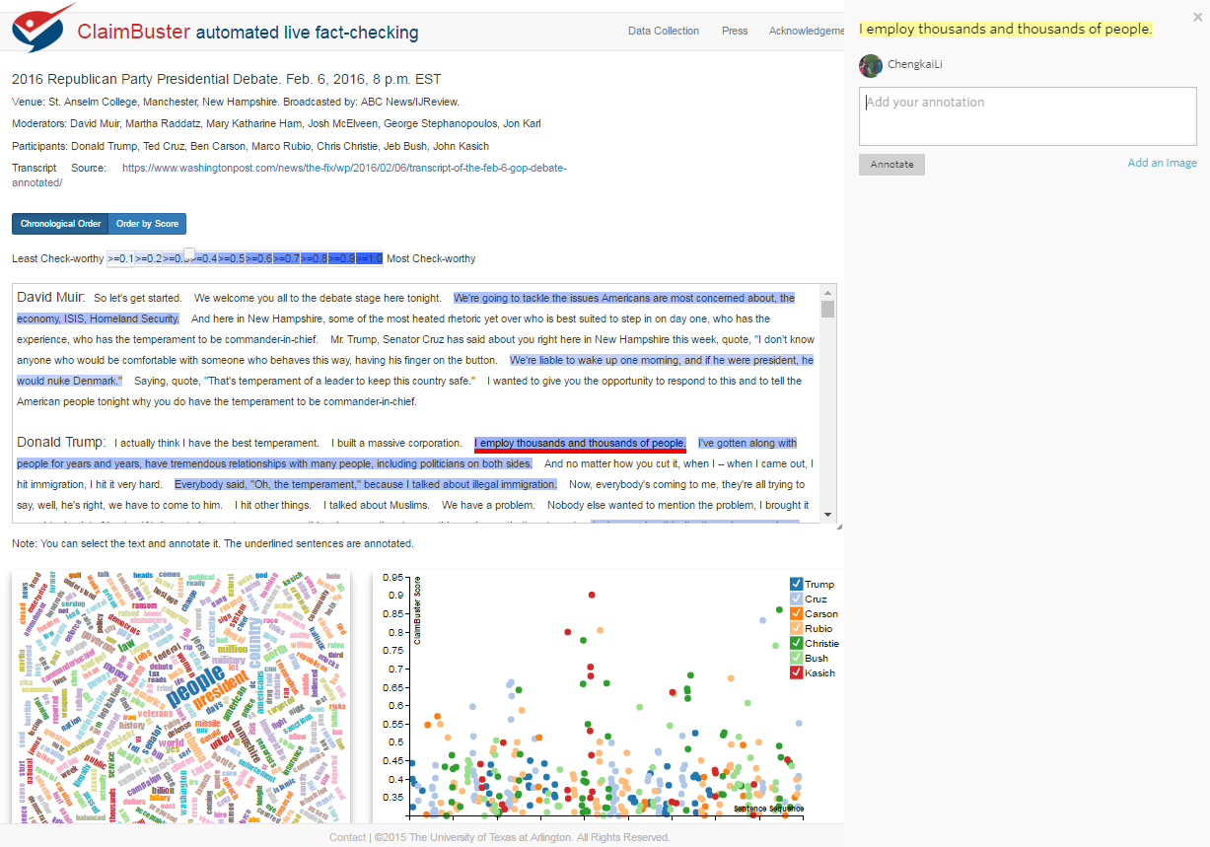
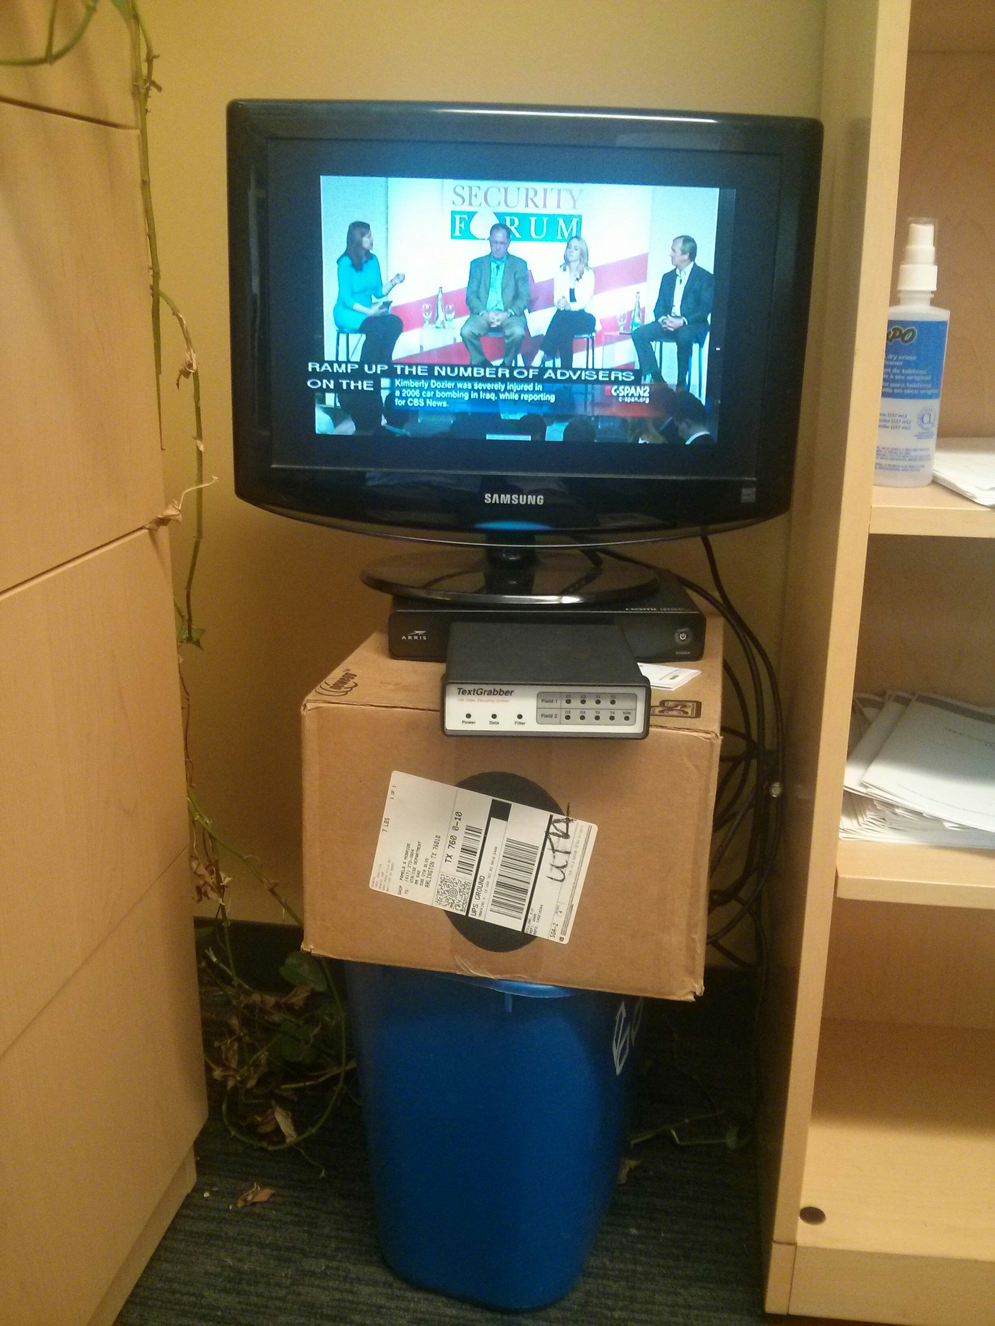
Live Coverage of Debates
Closed-caption decoder

Slide 6
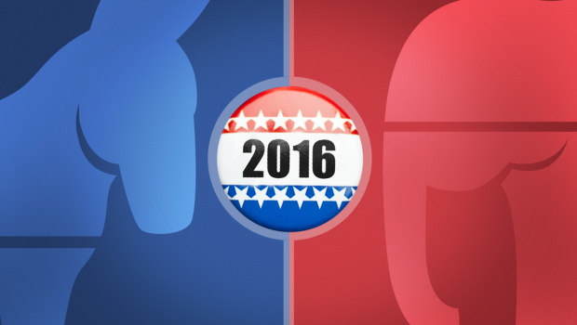




Finding Important Factual Claims:
A Supervised Learning Task
2016
Presidential
Debates
Human Annotation
Feature Extraction
Learning Algorithm
Ground Truth
Feature Vectors
Presidential Debate Transcripts (1960-2012)
Important factual claims

Slide 7
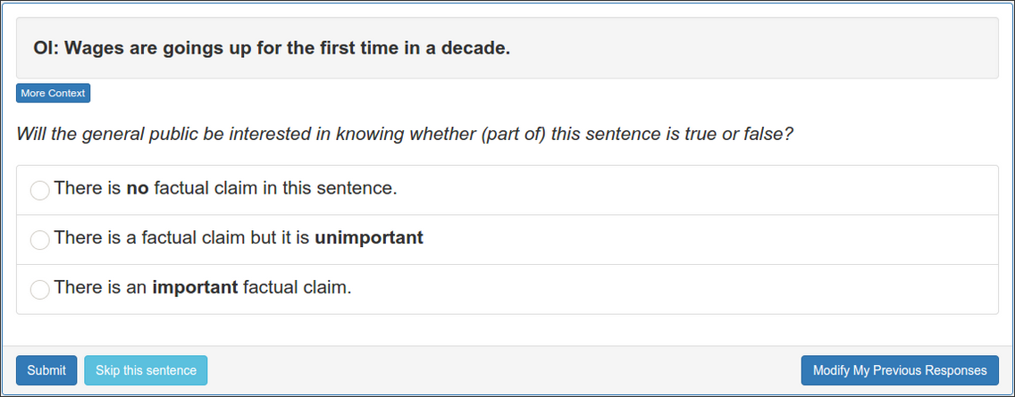
Training Dataset
Transcripts of all 30 debates (11 general elections) in history
20k sentences by candidates: removed very short (< 5 words) sentences
Ground truth collection website

Slide 8
Experiments
2016 U.S. Presidential Election Primary Debates
Transcripts of 21 debate (12 Republican, 9 Democratic)
30737 sentences
Collected fact-checks by PolitiFact and CNN
Detected topics of the sentences
12 Most Important Topics (MIP) used by Gallup*
For each topic, we manually created a set of keywords representing that topic. E.g., keywords for topic “Abortion”: {abortion, pregnancy, planned parenthood}
* M. E. McCombs and D. L. Shaw. The agenda-setting function of mass media. Public opinion quarterly, 1972
* T. W. Smith. America’s most important problem-a trend analysis. Public opinion quarterly, 1980

Slide 9
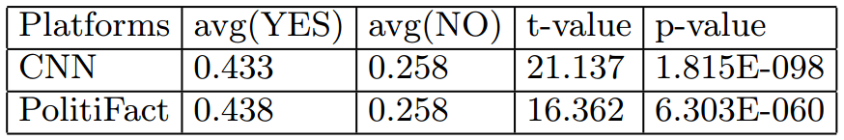
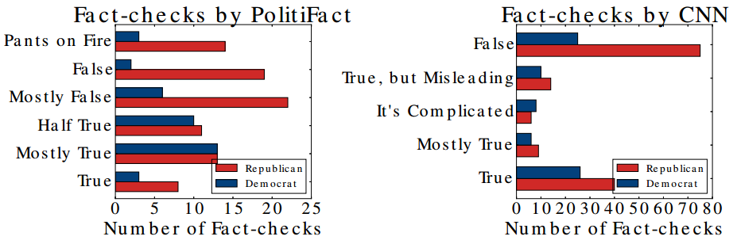
(1) Sentences selected by Journalism organizations (CNN and PolitiFact) for checking had ClaimBuster scores significantly higher (were more check-worthy) than sentences not selected for checking.
Notes:
We collected verdicts of fact-checks from CNN and PolitiFact. The ClaimBuster average for sentences fact-checked by CNN is 0.433 compared to 0.258 for those sentences not selected by CNN, a statistically significant difference. Likewise, the ClaimBuster average for sentences checked by PolitiFact is 0.438 compared to 0.258 for those not selected, also a significant difference. The results of these comparisons demonstrate the utility of ClaimBuster in identifying sentences likely to contain important factual claims.

Slide 10
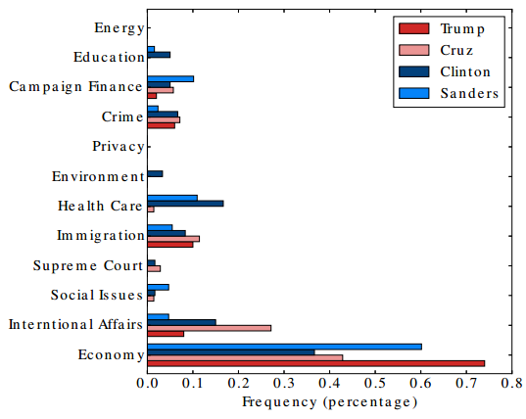
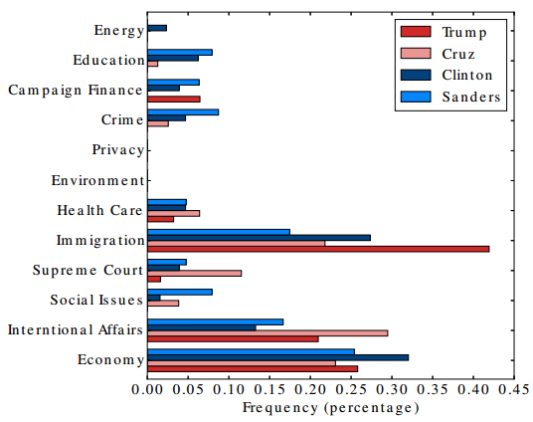
Distribution of topics over sentences scored high (≥ 0.5) by ClaimBuster
Distribution of topics over sentences scored low (≤ 0.3) by ClaimBuster
Notes:
One interesting observation derived from this and the last figure is that Republican candidates spoke about Health Care but used fewer factual claims regarding this topic. On the other hand, Democratic candidate Hillary Clinton presented factual statements related to Environment rather than presenting non-factual, subjective statements.

Slide 11
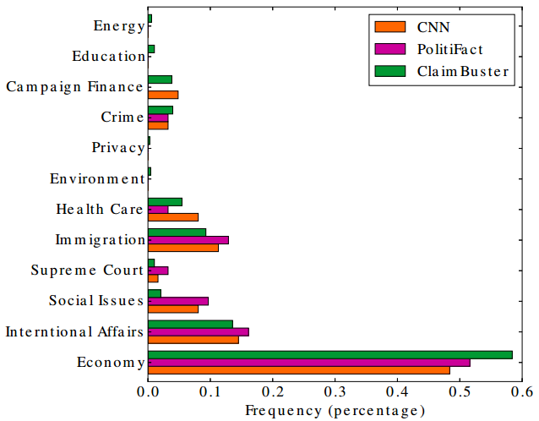
(2) ClaimBuster is similar to Journalism organizations (CNN and PolitiFact) in the distribution of topics among highly scored sentences (≥ 0.5) and fact-checked sentences.
Notes:
This figure shows the topic distributions of CNN, PolitiFact sentences as well as of highly check-worthy factual sentences (ClaimBuster score ≥ 0.5). This figure signifies that there are strong similarities between ClaimBuster and the fact-checking organizations. ClaimBuster tends to give high scores to the topics which CNN and PolitiFact tend to choose for fact checking. For example, all three have about 50 percent of the fact checks (or high ClaimBuster scores) associated with Economy, about 14 percent for International Affairs, about 10 percent for Immigration and 4 percent for Crime. One topic where ClaimBuster showed a difference with the human fact-checkers was Social Issues. That topic represented about 9 percent of the CNN and PolitiFact factchecks but only about 2 percent of the highly scored ClaimBuster sentences.

Slide 12
The Quest to Automate Fact-Checking
repository of fact-checks by professionals
claimed detected and ranked by check-worthiness
debates
interviews
speeches
political ads
social media
web
news
documents and reports
matched existing fact-checks: delivered via browser extensions, mobile apps, APIs, chatbots
new factual claims:
algorithmic fact-checking;
solicit analyses from professionals

Slide 13

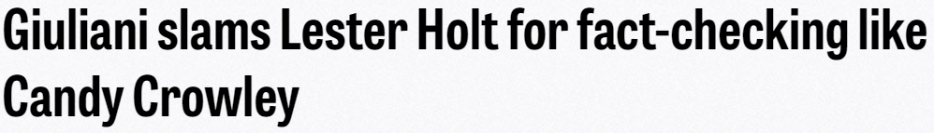
One Day Robot Fact-checkers will Dominate
Less subjective

Slide 14

One Day Robot Fact-checkers will Dominate
Restless and more efficient
satire

Slide 15
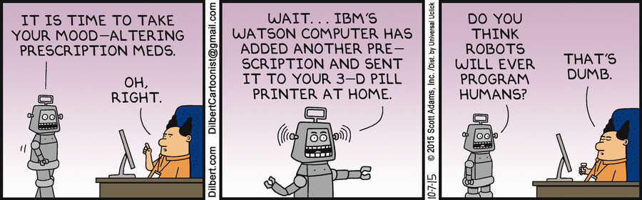
One Day Robot Fact-checkers will Dominate
More intelligent

Slide 16
Acknowledgment
Collaborators
UTA Students
Naeemul Hassan (graduated)
Fatma Arslan
Siddhant Gawsane
Aaditya Kulkarni
Joseph Minumol (graduated)
Vikas Sable
Gensheng Zhang
Many more students who are currently working on it
Bill Adair (Duke)
Pankaj Agarwal (Duke)
Peter Fray (UTS)
James Hamilton (Stanford)
Mark Tremayne (UTA)
Jun Yang (Duke)
Cong Yu (Google Research)

Slide 17



Acknowledgment
Funding sponsors
Disclaimer: This material is based upon work partially supported by the National Science Foundation Grants 1117369, 1408928 and 1565699 and a Knight Prototype Fund from the Knight Foundation. Any opinions, findings, and conclusions or recommendations expressed in this material are those of the author(s) and do not necessarily reflect the views of the funding agencies.

Slide 18
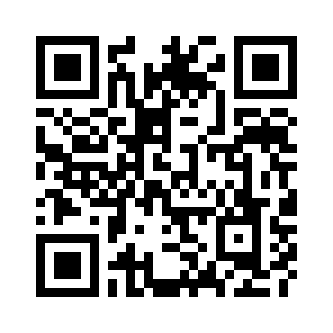
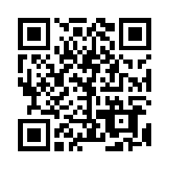
Thank You! Questions?
http://ranger.uta.edu/~cli
cli@uta.edu
Twitter @ClaimBusterTM
Prototype
http://idir.uta.edu/claimbuster
You are invited to contribute
http://bit.ly/claimbusters

